Slide 1
Occupational Radiological Protection in Interventional Procedures
ICRP Publication 139
Authors on behalf of ICRP
P. Ortiz López, L.T. Dauer, R. Loose, C.J. Martin, D.L. Miller, E. Vañó, M. Doruﬀ, R. Padovani, G. Massera, C. Yoder

Slide 2
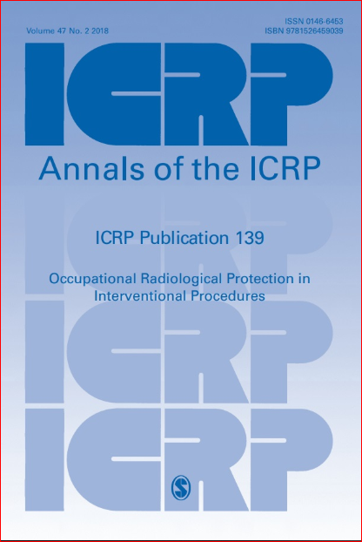

Slide 3
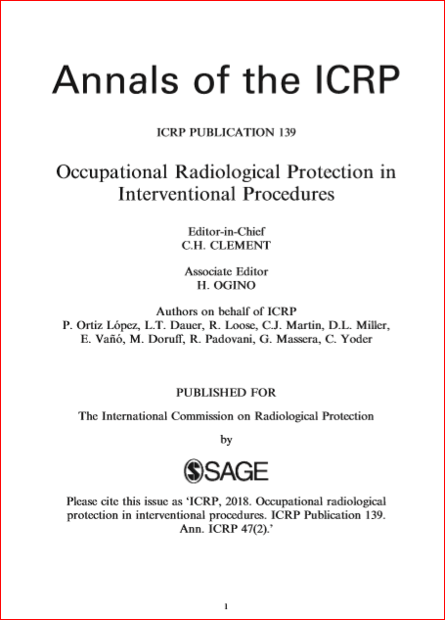

Slide 4
Disclosure
This slide set copies information from ICRP Publication 139 in Main Points and in Recommendations
Readers of this slide set are advised to go through the full publication for detailed information as this material is only a glimpse, rather than a comprehensive presentation of its contents

Slide 5
Section Headings in ICRP 139 This presentation only covers Main Points and Recommendations
Introduction
Issues
Application of the System of Occupational Protection to Interventional Procedures
Individual Monitoring and Dose Assessment
Radiological Protection Methods and Programme
Summary of Recommendations

Slide 6
Motivation for this Publication
In previous publications the Commission has provided practical advice for physicians and other healthcare personnel on measures to protect their patients and themselves during interventional procedures.
However there is a need for guidance for medical physicists, professionals in charge of occupational protection, regulators and dosimetry services on exposure monitoring strategies, radiological protection approaches and garments, their use and testing, education and training, the development of a radiological protection programme, and quality assurance for its implementation.
This publication is intended to meet this need

Slide 7
Main Points 1 (p 25, ICRP 139), Introduction
Minimally invasive interventions guided by radiological imaging have many advantages over conventional surgery for a number of medical conditions.
There is considerable variation in occupational exposure observed for the same type of procedure, suggesting that radiological protection practices can be improved.
In addition, studies have shown that there is an increased incidence of radiation-related eye lens opacities (pre-cataracts) in interventionalists and other professionals involved in interventional procedures.

Slide 8
Main Points 2 (p 29, ICRP 139), Issues
Interventions involving positron emission tomography (PET) and selective internal radiation therapy (SIRT) pose new and diﬀerent radiological protection challenges.
However, occupational exposure can be kept within appropriate ranges with optimisation and attention to radiation ﬁelds.

Slide 9
Main Points 3 (p 45, ICRP 139), Application of the protection principles
The objective of radiological protection is to manage exposure to ionising radiation so that tissue reactions (deterministic eﬀects) are prevented, and the risks of stochastic eﬀects are reduced to the extent reasonably achievable, societal and economic factors considered.
To achieve this objective, the Commission recommends three fundamental principles of radiological protection: justiﬁcation of practices, optimisation of protection, and dose limitation for individuals, who, in the context of this publication, are primarily the professionals involved in the interventions.
.

Slide 10
Main Points 4 (p 45, ICRP 139), Application of the protection principles
After a worker has declared her pregnancy, her working conditions should ensure that the additional dose to the conceptus does not exceed 1mSv during the remainder of the pregnancy.
Currently available data do not justify automatically precluding pregnant interventionalists or other workers from performing procedures in the intervention room (paragraph 244)
The employer, with the advice of the medical physicist or radiological protection expert, needs to carefully review the exposure conditions of pregnant workers.

Slide 11
Main Points 5 (p 51, ICRP 139) monitoring and dose assessment
Reliable exposure monitoring is essential for radiation safety professionals to have the information needed to oﬀer improvements to reduce doses and optimise radiological protection
Both high-dose readings and very low-dose readings may indicate misuse or failure to wear dosimeters.

Slide 12
Main Points 6 (p 51, ICRP 139), monitoring and dose assessment
Individual dosimeters should have a means to let the users identify their own dosimeters and their expected position.
When a member of staﬀ works for more than one employer, cooperation among them is essential for compliance by all responsible parties with the requirements for protection and safety. The sum of all the individual doses incurred at each of the facilities has to be obtained, and a complete dose record has to be maintained.

Slide 13
Main points 7 (p 69, ICRP 139) Radiological protection methods and programme
When protective eyewear is worn, eye exposure can still result from radiation scattered from the surrounding tissues of the interventionalist. The size of the lenses, the use of side shields, and the closeness of ﬁt to the facial contours are all important in determining the extent of protection provided.
Ceiling-suspended lead-acrylic shields can reduce doses to the head and neck by a factor of 2–10.

Slide 14
Main points 8 (p 69, ICRP 139) Radiological protection methods and programme
The operator’s feet may be exposed even when lead curtains suspended from the table top are in place, especially in the case of tall operators who need a high table top position.

Slide 15
Main points 9 (p 69, ICRP 139) Radiological protection methods and programme
Ambient monitors (such as on the C-arm) are useful to assess scatter radiation ﬁelds continually, to provide backup to personal dosimetry, to discover non-compliance in wearing individual dosimeters, and to help estimate occupational doses when personal dosimeters have not been worn.

Slide 16
Main points 9 (p 69, ICRP 139) Radiological protection methods and programme
Staﬀ in charge of occupational protection need knowledge of general radiological protection, but also need to be familiar with:
clinical practice,
interventional procedures, and
the x-ray equipment used in interventions guided by radiological imaging.

Slide 17
Recommendations 1 (pp 91-94, ICRP 139)
Occupational exposure in interventional procedures is closely related to patient exposure, as most actions to reduce patient exposure also contribute to protection of workers
Occupational exposure requires the use of protective garments and shielding
Actions to protect staﬀ should not impair the clinical outcome of the intervention, and should not increase patient exposure
Therefore, occupational protection should be managed in an integrated approach with patient protection

Slide 18
Recommendations 2 (pp 91-94, ICRP 139)
Occupational exposure monitoring in interventional procedures has two major purposes: to verify compliance with dose limits, and to optimise occupational protection
Compliance monitoring should include the assessment of eﬀective dose, but also of doses received by non-apron-protected organs, such as the lens of the eye and extremities

Slide 19
Recommendations 2 (pp 91-94 , ICRP 139)
It is essential that professionals wear their dosimeters correctly. Two dosimeters, one shielded by the apron (under apron) and one unshielded (over apron) at collar level, provide the best estimate of eﬀective dose and have been recommended by the Commission.
The under-apron dosimeter also provides conﬁrmation that the apron has actually been worn, and that its shielding is suﬃcient to keep the dose under the apron low.
The over-apron dosimeter also provides an estimation of the dose to the lens of the eye.

Slide 20
Recommendations 3 (pp 91-94 , ICRP 139)
Visual elements should be in place to help users place their own dosimeters in the correct position.
Consistency analysis of the two readings allows an indication of the proper use of the dosimeters, making the monitoring system more robust.

Slide 21
Recommendations 4 (pp 91-94 , ICRP 139)
Optimisation monitoring evaluates the eﬀect of protective actions to reduce staﬀ doses without impairment of the success of the procedures.
Active electronic personal dosimeters (APDs) have proven to be useful for optimisation purposes, for studies of radiation exposure by type of procedure or for speciﬁc aspects of a procedure, and for educational purposes.
Type-test procedures and calibration of APDs and area monitors should include radiation ﬁelds representative of those encountered in interventional procedures, including tests in pulsed mode with high dose rates.

Slide 22
Recommendations 5 (pp 91-94 , ICRP 139)
For managing optimisation of protection, investigation levels are required to provide an alert when radiation exposure is higher than normal, and a review of the working conditions is needed.
In addition, a low-dose investigation level for the reading of over-apron and hand dosimeters can also be used to trigger a review of whether dosimeters are worn consistently and properly when the readings of these dosimeters are lower than expected.

Slide 23
Recommendations 6 (pp 91-94 , ICRP 139)
Wrist dosimeters may not be able to reﬂect actual ﬁnger doses, if parts of the hands are very close to or even introduced into the direct x-ray beam.
Consideration should be given to assess doses to the parts of the legs that are not shielded by the protective apron or table-suspended curtains.
Improvements in technology and methodology are needed to assess dose to the lens of the eye when lead glasses are worn

Slide 24
Recommendations 7 (pp 91-94 , ICRP 139)
All staﬀ in the room should wear protective aprons
In addition, the interventionalist should be protected by ceiling-suspended screens, table-suspended curtains, and shielding drapes when feasible.
Other staﬀ, such as nurses and anaesthesia personnel, who need to remain near the patient, can beneﬁt from protection by movable screens; other personnel can also beneﬁt from protection by distance.

Slide 25
Recommendations 8 (pp 91-94 , ICRP 139)
Ceiling-suspended lead-acrylic shields should always be included in interventional installations, as they can reduce doses to the head and neck by a factor of 2–10.

Slide 26
Recommendations 9 (pp 91-94 , ICRP 139)
Lighter-weight aprons that contain composite layers or bi-layers of high atomic number elements such as tin or bismuth, instead of lead, are also available.
Characterising attenuation properties only in terms of ‘lead equivalence’ can be misleading, since photon attenuation varies over the photon energy spectrum, with the largest variations occurring in the imaging range.
Therefore, attenuation factors should be given together with information on the radiation beam qualities used to measure the attenuation and the weighting of measurements made at diﬀerent beam qualities, in order to reﬂect the conditions under which the garment is used.

Slide 27
Recommendations 10 (pp 91-94 , ICRP 139)
When SIRT is performed, all vials containing ⁹⁰Y, all instruments, and disposable items used for preparing the dose and implanting the device should be handled with forceps and appropriate shielding to reduce ﬁnger doses.
Due to the high-energy beta emission, shielding should be provided with a low atomic number material such as acrylic.

Slide 28
Recommendations 11 (pp 91-94 , ICRP 139)
Adequate resources should be provided for the purchase, testing, and replacement of protective garments.
Acceptability criteria for the protective garments should be established and applied in the facility.
Protective aprons should never be folded, as cracks in the protective lining can develop at the fold.

Slide 29
Recommendations 12 (pp 91-94 , ICRP 139)
A comprehensive quality assurance programme should be established by the organisation.
The programme should aim to maintain best radiological protection practices to ensure appropriate occupational exposure control.
The programme should include appropriate audits to ensure that personnel adhere to procedures, especially related to wearing of dosimeters, protective devices, and methods to optimise occupational protection.

Slide 30
Recommendations 13 (pp 91-94 , ICRP 139)
The radiological protection programme should include audits of occupational doses, investigation of abnormal exposure, reporting and recording results, and corrective actions if appropriate.
Protective aprons should be inspected visually prior to each use for damage and defects, kinks, and irregularities. They should also be inspected with x- rays for any defects in the protective material upon receipt, and annually thereafter for any deterioration.
Written procedures to clean protective equipment while avoiding damage to the item should be included in the quality assurance programme

Slide 31
Recommendations 14 (pp 91-94 , ICRP 139)
Staﬀ involved in interventional procedures need initial and periodic education and training in applying the quality assurance programme, including strategies for exposure monitoring and dose assessment, and protection methods and garments.
Medical physicists and radiological protection specialists who provide support to interventional facilities should have the highest level of training in radiological protection, as they have additional responsibilities as trainers for interventionalists and other health professionals involved in interventions (ICRP, 2009).

Slide 32
Recommendations 15 (pp 91-94 , ICRP 139)
Dosimetry services staﬀ need background knowledge of clinical practice in order to calibrate dosimeters (e.g. radiation qualities, scatter radiation ﬁelds, pulsed radiation) and to collaborate with the user in investigating abnormal dose values.
Staff in charge of occupational protection, dosimetry services staﬀ, clinical applications specialists from suppliers, and regulators need not only knowledge of general radiological protection, but also knowledge of clinical practice in interventional procedures and the characteristics of x-ray equipment used.

Slide 33
Recommendations 16 (pp 91-94 , ICRP 139)
Records on occupational exposure should include information on the nature of the work, exposure from work for other employers, outcomes of health surveillance, education and training on radiological protection (including refresher courses), and results of exposure monitoring and dose assessments, including results of investigation of abnormal exposure values. Employers must provide staﬀ with access to records of their own occupational exposure.

Slide 34
Publication to be cited as
ICRP, 2018. Occupational Radiological Protection in Interventional Procedures. ICRP Publication 139. Ann. 47(2) ICRP, pp (1-112).

Slide 35
www.icrp.org

